Slide 1

Chapter 3
Problem-solving Agents

Slide 2
1.9 Problem-Solving Agents
According to psychology, “a problem-solving refers to a state where we wish to reach to a definite goal from a present state or condition.”
According to computer science, a problem-solving is a part of artificial intelligence which encompasses a number of techniques such as algorithms, heuristics to solve a problem.
Problem-solving agent in AI is goal-based agents that focus on goals, which uses a group of algorithms, and techniques to solve a well-defined problem.
And these agents are different from reflex agents who just have to map states into actions and can’t map when storing and learning both are bigger.
The Problem Solving Agents decide what to do by finding a sequence of actions that leads to a desirable state or solution.
The different stages that Problem-solving agents perform, to arrive at a desired state or solution are:
          Articulating or expressing the desired goal and the problem is tried upon, clearly.
          Explore and examine
          Find the solution from the various algorithms on the table.
          The final step is Execution!
The problem-solving agent performs precisely by defining problems and several solutions.

Slide 3
Steps performed by Problem-solving agent
Goal Formulation: It is the first and simplest step in problem-solving. It organizes the steps/sequence required to formulate one goal out of multiple goals as well as actions to achieve that goal. Goal formulation is based on the current situation and the agent’s performance measure.
Problem Formulation: It is the most important step of problem-solving which decides what actions should be taken to achieve the formulated goal.
There are following five components involved in problem formulation:
  Initial State: It is the starting state or initial step of the agent towards its goal.
  Actions: It is the description of the possible actions available to the agent.
  Transition Model: It describes what each action does.
  Goal Test: It determines if the given state is a goal state.
  Path cost: It assigns a numeric cost to each path that follows the goal.
The problem-solving agent selects a cost function, which reflects its performance measure. An optimal solution has the lowest path cost among all the solutions.

Slide 4
Initial state, actions, and transition model together define the state-space of the problem.
State-space of a problem is a set of all states which can be reached from the initial state followed by any sequence of actions.
The state-space forms a directed map or graph where nodes are the states, links between the nodes are actions, and the path is a sequence of states connected by the sequence of actions.
  Search: It identifies all the best possible sequence of actions to reach the goal state from the current state. It takes a problem as an input and returns solution as its output.
  Solution: It finds the best algorithm out of various algorithms, which may be proven as the best optimal solution.
  Execution: It executes the best optimal solution from the searching algorithms to reach the goal state from the current state.

Slide 5
Well-defined problems and solutions
Simple problem solving agent, it first formulates a goal and a problem, searches for a sequence of actions that would solve the problem, and then executes the actions one at a time. When this is complete, it formulates another goal and starts over.
        function SIMPLE-PROBLEM-SOLVING-AGENT(percept) returns an action
        persistent: seq, an action sequence, initially empty
        state, some description of the current world state
        goal, a goal, initially null
        problem, a problem formulation
        state ← UPDATE-STATE(state, percept)
        if seq is empty then
        goal ← FORMULATE-GOAL(state)
        Problem ← FORMULATE-PROBLEM(state, goal)
        seq ← SEARCH(problem)
        if seq = failure then return a null action
        action ← FIRST(seq)
        seq ← REST(seq)
        return action

Slide 6
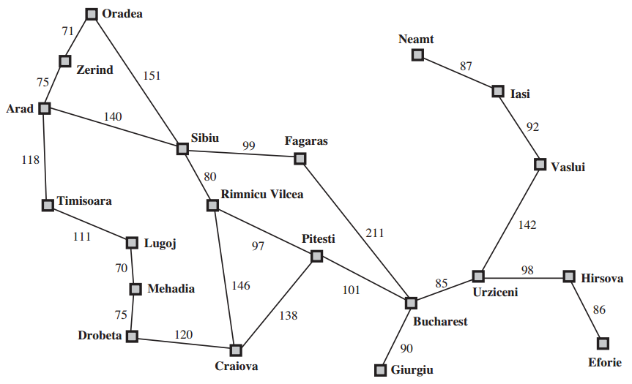
A simplified road map of part of Romania

Slide 7
INITIAL STATE The initial state that the agent starts in. For example, the initial state for our agent in Romania might be described as In(Arad).
ACTIONS A description of the possible actions available to the agent. Given a particular state s, ACTIONS(s) returns the set of actions that can be executed in s. We say that each of APPLICABLE these actions is applicable in s.
For example, from the state In(Arad), the applicable actions are {Go(Sibiu), Go(Timisoara), Go(Zerind)}.
TRANSITION MODEL A description of what each action does; the formal name for this is the transition model, specified by a function RESULT(s, a) that returns the state that results from doing action a in state s. We also use the term successor to refer to any state reachable from a given state by a single action.
For example, we have RESULT(In(Arad),Go(Zerind)) = In(Zerind) .

Slide 8
GOAL TEST The goal test, which determines whether a given state is a goal state. Sometimes there is an explicit set of possible goal states, and the test simply checks whether the given state is one of them. The agent’s goal in Romania is the singleton set {In(Bucharest)}.
Sometimes the goal is specified by an abstract property rather than an explicitly enumerated set of states. For example, in chess, the goal is to reach a state called “checkmate,” where the opponent’s king is under attack and can’t escape.
PATH COST A path cost function that assigns a numeric cost to each path. The problem-solving agent chooses a cost function that reflects its own performance measure. For the agent trying to get to Bucharest, so the cost of a path might be its length in kilometers.

Slide 9
1.10 Example Problems
The problem-solving approach has been applied to a vast array of task environments.
Toy problems The first example we examine is the vacuum world This can be formulated as a problem as follows:
States: The state is determined by both the agent location and the dirt locations. The agent is in one of two locations, each of which might or might not contain dirt. Thus, there are 2 × 2(2) = 8 possible world states. A larger environment with n locations has n · 2n states.
Initial state: Any state can be designated as the initial state.
Actions: In this simple environment, each state has just three actions: Left, Right, and Suck. Larger environments might also include Up and Down.
Transition model: The actions have their expected effects, except that moving Left in the leftmost square, moving Right in the rightmost square, and Sucking in a clean square have no effect.
Goal test: This checks whether all the squares are clean.
Path cost: Each step costs 1, so the path cost is the number of steps in the path.

Slide 10
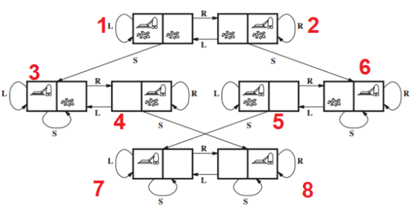

Slide 11
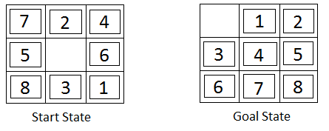
The 8-puzzle(Sliding tile)
The 8-puzzle, an instance of which is shown in Figure, consists of a 3×3 board with eight numbered tiles and a blank space.
A tile adjacent to the blank space can slide into the space. The object is to reach a specified goal state, such as the one shown on the right of the figure.
The standard formulation is as follows
States: A state description specifies the location of each of the eight tiles and the blank in one of the nine squares.
Initial state: Any state can be designated as the initial state. Note that any given goal can be reached from exactly half of the possible initial states .

Slide 12
Actions: The simplest formulation defines the actions as movements of the blank space Left, Right, Up, or Down. Different subsets of these are possible depending on where the blank is.
Transition model: Given a state and action, this returns the resulting state; for example, if we apply Left to the start state in Figure, the resulting state has the 5 and the blank switched.
Goal test: This checks whether the state matches the goal configuration shown in Figure. (Other goal configurations are possible.)
Path cost: Each step costs 1, so the path cost is the number of steps in the path.

Slide 13
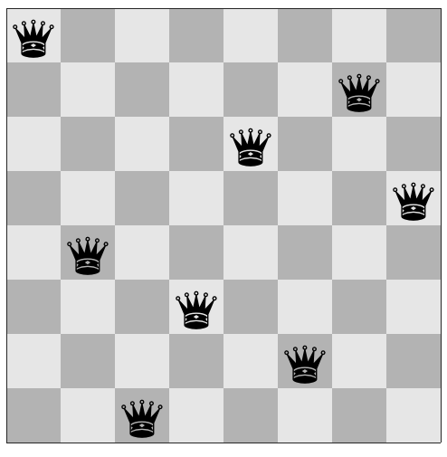
8-queens problem
The goal of the 8-queens problem is to place eight queens on a chessboard such that no queen attacks any other. (A queen attacks any piece in the same row, column or diagonal)
The first incremental formulation one might try is the following:
States: Any arrangement of 0 to 8 queens on the board
is a state.
Initial state: No queens on the board.
Actions: Add a queen to any empty square.
Transition model: Returns the board with a queen
added to the specified square.
Goal test: 8 queens are on the board, none attacked.

Slide 14
Real-world problems
Route-finding algorithms are used in a variety of applications.
Such as routing video streams in computer networks, military operations planning, and airline travel-planning systems, involve much more complex specifications. Consider the airline travel problems that must be solved by a travel-planning Web site.
  States: Each state obviously includes a location (e.g., an airport) and the current time. Furthermore, because the cost of an action (a flight segment) may depend on previous segments, their fare bases, and their status as domestic or international, the state must record extra information about these “historical” aspects.
  Initial state: This is specified by the user’s query.
  Actions: Take any flight from the current location, in any seat class, leaving after the current time, leaving enough time for within-airport transfer if needed.
  Transition model: The state resulting from taking a flight will have the flight’s destination as the current location and the flight’s arrival time as the current time.
  Goal test: Are we at the final destination specified by the user?
  Path cost: This depends on monetary cost, waiting time, flight time, customs and immigration procedures, seat quality, time of day, type of airplane, frequent-flyer mileage awards, and so on

Slide 15
The traveling salesperson problem (TSP) is a touring problem in which each city must be visited exactly once. The aim is to find the shortest tour.
The problem is known to be NP-hard, but an enormous amount of effort has been expended to improve the capabilities of TSP algorithms.
In addition to planning trips for traveling salespersons, these algorithms have been used for tasks such as planning movements of automatic circuit-board drills and of stocking machines on shop floors.

Slide 16
A VLSI layout problem
Requires positioning millions of components and connections on a chip to minimize area, minimize circuit delays, minimize stray capacitances, and maximize manufacturing yield.
The layout problem comes after the logical design phase and is usually split into two parts:
i)cell layout ii)channel routing.
In cell layout, the primitive components of the circuit are grouped into cells, each of which performs some recognized function.
Each cell has a fixed footprint (size and shape) and requires a certain number of connections to each of the other cells.
The aim is to place the cells on the chip so that they do not overlap and so that there is room for the connecting wires to be placed between the cells.
Channel routing finds a specific route for each wire through the gaps between the cells. These search problems are extremely complex, but definitely worth solving.

Slide 17
Robot navigation
It is a generalization of the route-finding problem described earlier.
Rather than following a discrete set of routes, a robot can move in a continuous space with (in principle) an infinite set of possible actions and states.
For a circular robot moving on a flat surface, the space is essentially two-dimensional.
When the robot has arms and legs or wheels that must also be controlled, the search space becomes many-dimensional.
Advanced techniques are required just to make the search space finite.

Slide 18
1.11 Searching for Solutions
A solution is an action sequence, so search algorithms work by considering various possible action sequences.
The possible action sequences starting at the initial state form a search tree with the initial state at the root; the branches are actions and the nodes correspond to states in the state space of the problem.
The root node of the tree corresponds to the initial state, In(Arad).
The first step is to test whether this is a goal state. (Clearly it is not, but it is important to check so that we can solve trick problems like “starting in Arad, get to Arad.”) Then we need to consider taking various actions.
We do this by expanding the current state; that is, applying each legal action to the current state, thereby generating a new set of states.
In this case, we add three branches from the parent node In(Arad) leading to three new child nodes: In(Sibiu), In(Timisoara), and In(Zerind). Now we must choose which of these three possibilities to consider further.

Slide 19
Loopy paths are a special case of the more general concept of redundant paths, which exist whenever there is more than one way to get from one state to another.
Consider the paths Arad–Sibiu (140 km long) and Arad–Zerind–Oradea–Sibiu (297 km long). Obviously, the second path is redundant—it’s just a worse way to get to the same state.
If you are concerned about reaching the goal, there’s never any reason to keep more than one path to any given state, because any goal state that is reachable by extending one path is also reachable by extending the other.

Slide 20
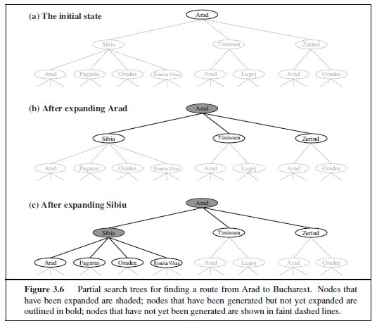

Slide 21
The way to avoid exploring redundant paths is to remember where one has been. To do this, we augment the TREE-SEARCH algorithm with a data structure called the explored set (also CLOSED LIST known as the closed list), which remembers every expanded node.
Newly generated nodes that match previously generated nodes—ones in the explored set can be discarded instead of being added to the frontier.
The new algorithm, called GRAPH-SEARCH, is shown informally in Figure.

Slide 22
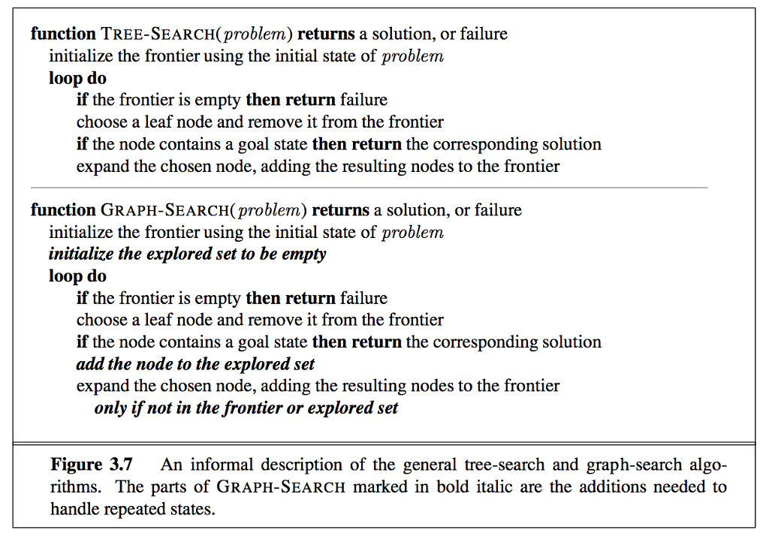

Slide 23
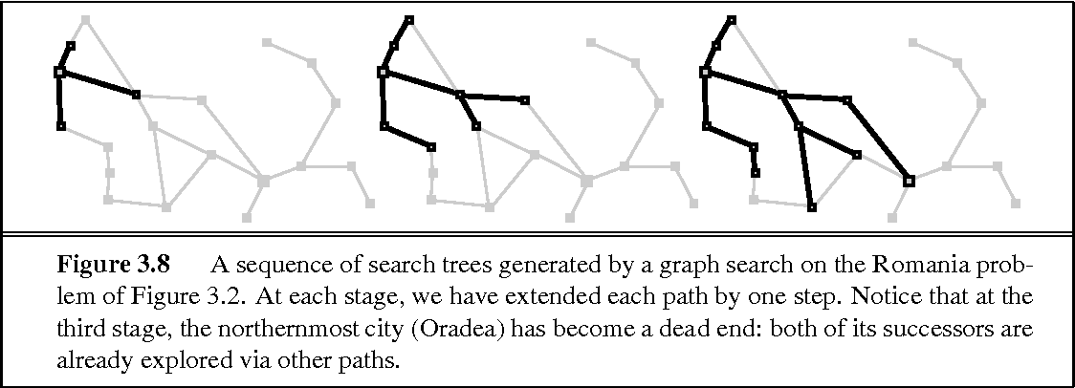
Clearly, the search tree constructed by the GRAPH-SEARCH algorithm contains at most one copy of each state, so we can think of it as growing a tree directly on the state-space graph, as shown in Figure .
The algorithm has another nice property: the frontier separates the state-space graph into the explored region and the unexplored region, so that every path from the initial state to an unexplored state has to pass through a state in the frontier.

Slide 24
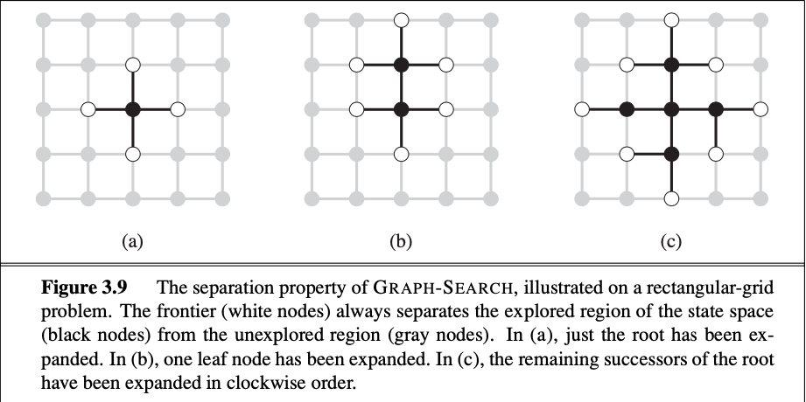
As every step moves a state from the frontier into the explored region while moving some states from the unexplored region into the frontier, we see that the algorithm is systematically examining the states in the state space, one by one, until it finds a solution.

Slide 25
Best-First Search
Best-first search is based on expanding the best partial path from current node to goal node. Here forward motion is from the best open node so far in the partially developed tree.
Best First Search is an informed search that uses an evaluation function to decide which adjacent is the most promising before it can continue to explore.
The cost of partial paths is calculated using some heuristic.
If the state has been generated earlier and new path is better than the previous one, then change the parent and update the cost.
It is not guaranteed to find an optimal solution, but generally it finds some solution faster than solution obtained from any other method.
The performance varies directly with the accuracy of the heuristic evaluation function.

Slide 26
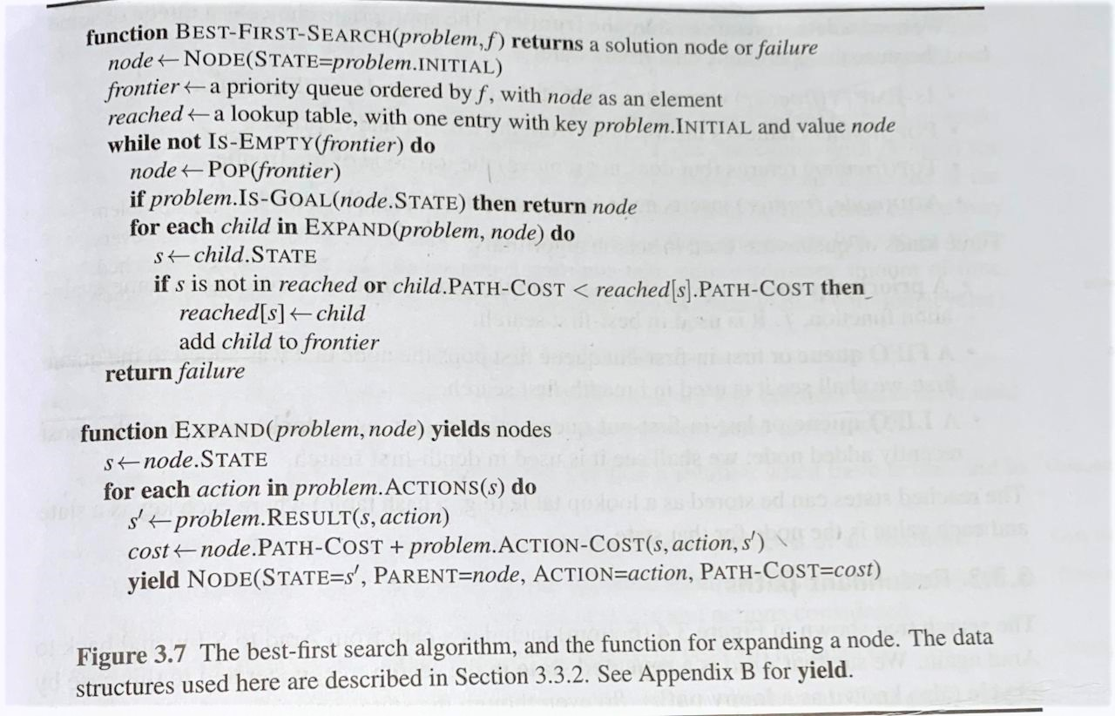

Slide 27
Infrastructure for search algorithms
Search algorithms require a data structure to keep track of the search tree that is being constructed.
For each node n of the tree, we have a structure that contains four components:
n.STATE: the state in the state space to which the node corresponds;
n.PARENT: the node in the search tree that generated this node;
n.ACTION: the action that was applied to the parent to generate the node;
n.PATH-COST: the cost, traditionally denoted by g(n), of the path from the initial state to the node, as indicated by the parent pointers
Given the components for a parent node, it is easy to see how to compute the necessary components for a child node.

Slide 28
The function CHILD-NODE takes a parent node and an action and returns the resulting child node:
  function CHILD-NODE(problem, parent, action) returns a node
  return a node with
  STATE = problem. RESULT(parent . STATE, action),
  PARENT = parent,
  ACTION = action,
  PATH-COST = parent. PATH-COST + problem. STEP-COST(parent . STATE, action)
Now that we have nodes, we need somewhere to put them.
The frontier needs to be stored in such a way that the search algorithm can easily choose the next node to expand according to its preferred strategy.
The appropriate data structure for this is a queue. The operations on a queue are as follows:
  EMPTY?(queue) returns true only if there are no more elements in the queue.
  POP(queue) removes the first element of the queue and returns it.
  INSERT(element, queue) inserts an element and returns the resulting queue

Slide 29
Measuring problem-solving performance
Following are the four essential properties of search algorithms to compare the efficiency of these algorithms:
    Completeness: A search algorithm is said to be complete if it guarantees to return a solution if at least any solution exists for any random input.
    Optimality: If a solution found for an algorithm is guaranteed to be the best solution (lowest path cost) among all other solutions, then such a solution for is said to be an optimal solution.
    Time Complexity: Time complexity is a measure of time for an algorithm to complete its task.
    Space Complexity: It is the maximum storage space required at any point during the search, as the complexity of the problem.

Slide 30
1.12 Uninformed Search Algorithms
Uninformed search algorithms do not have any domain knowledge. It works in a brute force manner and hence also called brute force algorithms.
It has no knowledge about how far the goal node is, it only knows how to traverse and distinguish between a leaf node and goal node.
It examines every node without any prior knowledge hence also called blind search algorithms.
Following are the various types of uninformed search algorithms:
                Breadth-first Search
                Depth-first Search
                Depth-limited Search
                Iterative deepening depth-first search
                Uniform cost search
                Bidirectional Search

Slide 31
Breadth-first search
Breadth-first search is a simple strategy in which the root node is expanded first, then all the successors of the root node are expanded next, then their successors, and so on.
In general, all the nodes are expanded at a given depth in the search tree before any nodes at the next level are expanded
Breadth-first search is an instance which uses a FIFO queue for the frontier.
Thus, new nodes (which are always deeper than their parents) go to the back of the queue, and old nodes, which are shallower than the new nodes, get expanded first.
There is one slight tweak on the general graph-search algorithm, which is that the goal test is applied to each node when it is generated rather than when it is selected for expansion.
It discards any new path to a state which is already in the frontier or explored set.

Slide 32
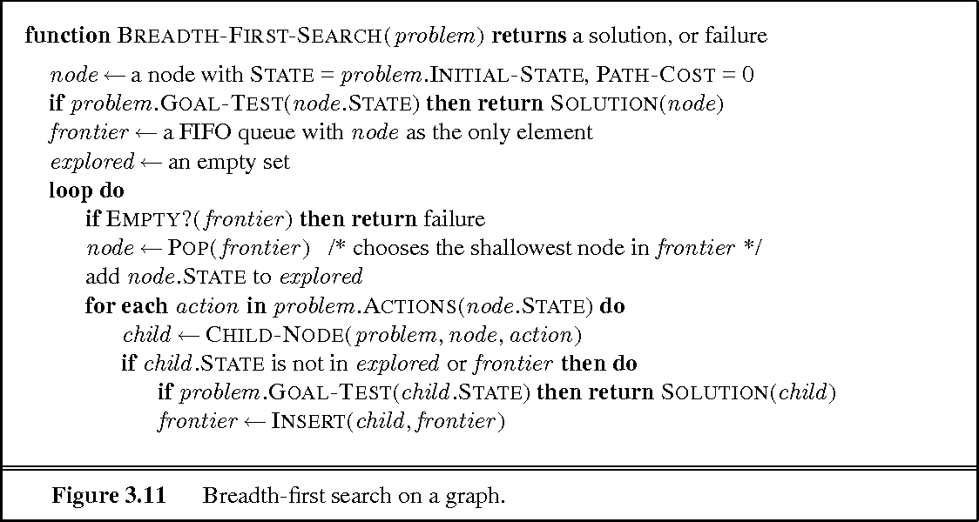
Breadth-first search on a graph

Slide 33
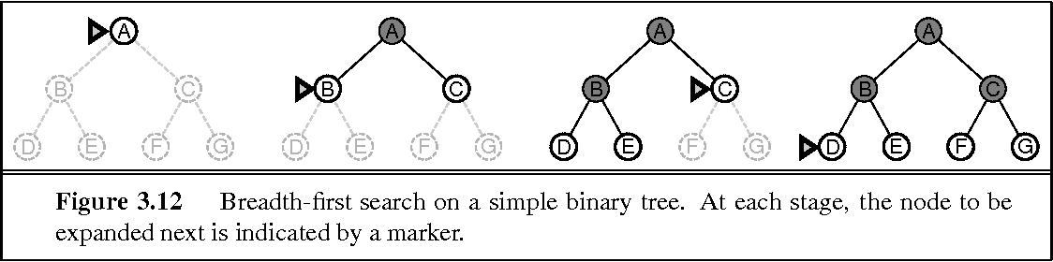
Figure shows the progress of the search on a simple binary tree
Advantages:
BFS will provide a solution if any solution exists.
If there are more than one solutions for a given problem, then BFS will provide the minimal solution which requires the least number of steps.
Disadvantages:
It requires lots of memory since each level of the tree must be saved into memory to expand the next level.
BFS needs lots of time if the solution is far away from the root node.

Slide 34
Time Complexity: Time Complexity of BFS algorithm can be obtained by the number of nodes traversed in BFS until the shallowest Node. Where the d= depth of a node(solution) and b is a branching factor.
T (b) = O (b^{d})
Space Complexity: Space complexity of BFS algorithm is given by the Memory size of frontier which is O(b^{d}).
Completeness: BFS is complete, which means if the shallowest goal node is at some finite depth, then BFS will find a solution.
Optimality: BFS is optimal if path cost is a non-decreasing function of the depth of the node.

Slide 35
Uniform-cost search
Unlike BFS, this uninformed search explores nodes based on their path cost from the root node.
It expands a node n having the lowest path cost g(n), where g(n) is the total cost from a root node to node n.
Uniform-cost search is significantly different from the breadth-first search because of the following two reasons:
  First, the goal test is applied to a node only when it is selected for expansion not when it is first generated because the first goal node which is generated may be on a suboptimal path.
  Secondly, a goal test is added to a node, only when a better/ optimal path is found.
Thus, uniform-cost search expands nodes in a sequence of their optimal path cost because before exploring any node, it searches the optimal path.
Also, the step cost is positive so, paths never get shorter when a new node is added in the search.

Slide 36
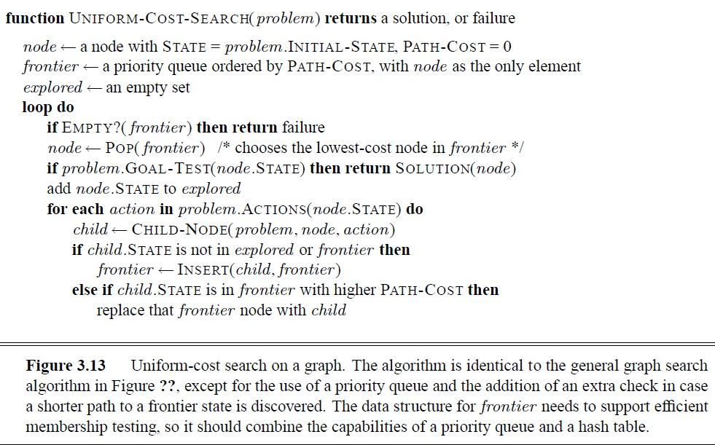

Slide 37
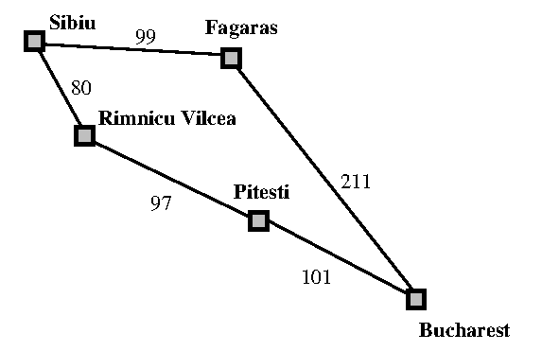
Where the problem is to get from Sibiu to Bucharest. The successors of Sibiu are Rimnicu Vilcea and Fagaras, with costs 80 and 99, respectively.
The least-cost node, Rimnicu Vilcea, is expanded next,
adding Pitesti with cost 80 + 97 = 177.
The least-cost node is now Fagaras, so it is expanded,
adding Bucharest with cost 99 + 211 = 310.
Now a goal node has been generated, but uniform-cost
search keeps going, choosing Pitesti for expansion and
adding a second path to Bucharest with cost 80+ 97+ 101 = 278.
Now the algorithm checks to see if this new path is better than the old one; it is, so the old one is discarded. Bucharest, now with g-cost 278, is selected for expansion and the solution is returned.

Slide 38
Depth-first search
Depth-first search always expands the deepest node in the current frontier of the search tree.
The search proceeds immediately to the deepest level of the search tree, where the nodes have no successors.
As those nodes are expanded, they are dropped from the frontier, so then the search “backs up” to the next deepest node that still has unexplored successors.
The breadth-first-search uses a FIFO queue, depth-first search uses a LIFO queue.
A LIFO queue means that the most recently generated node is chosen for expansion.
This must be the deepest unexpanded node because it is one deeper than its parent—which, in turn, was the deepest unexpanded node when it was selected.
The properties of depth-first search depend strongly on whether the graph-search or tree-search version is used.
The graph-search version, which avoids repeated states and redundant paths, is complete in finite state spaces because it will eventually expand every node.

Slide 39
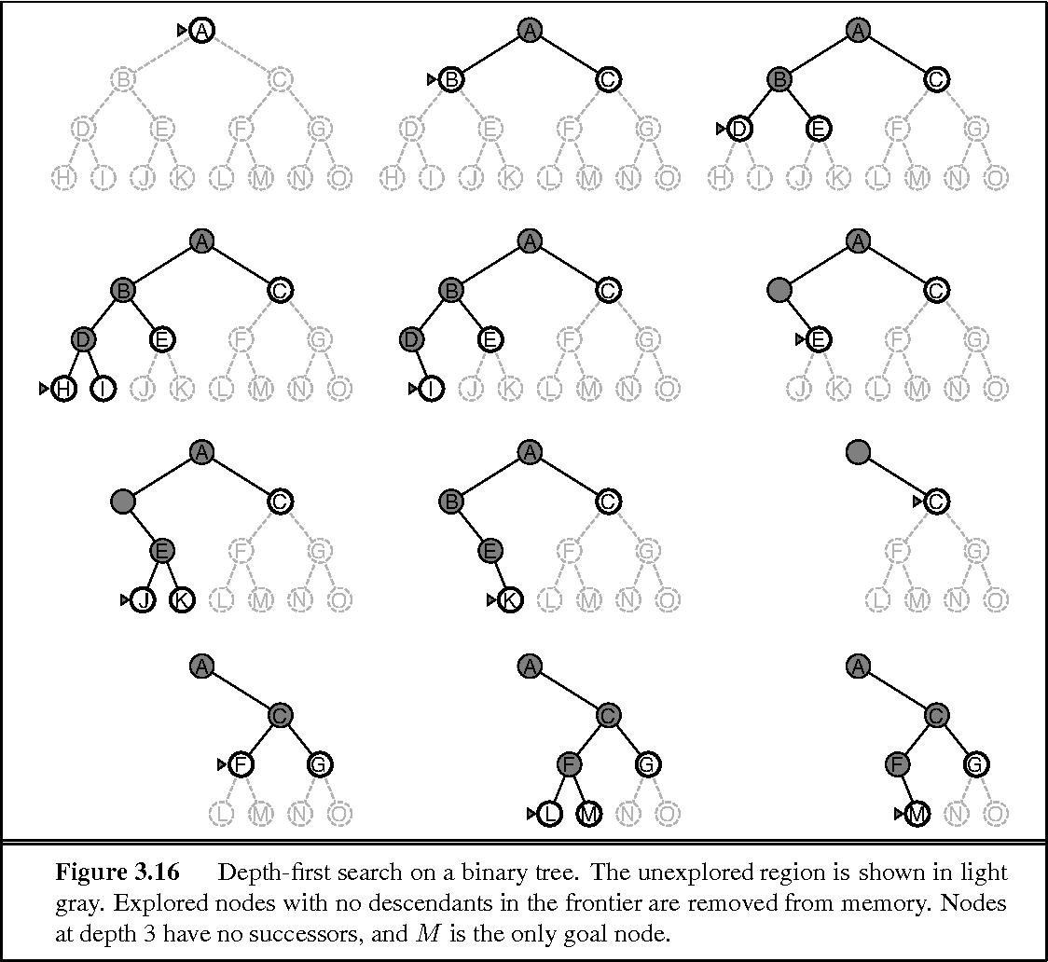

Slide 40
Advantage:
DFS requires very less memory as it only needs to store a stack of the nodes on the path from root node to the current node.
It takes less time to reach to the goal node than BFS algorithm (if it traverses in the right path).
Disadvantage:
There is the possibility that many states keep re-occurring, and there is no guarantee of finding the solution.
DFS algorithm goes for deep down searching and sometime it may go to the infinite loop.

Slide 41
Depth-limited search
This search strategy is similar to DFS with a little difference.
The difference is that in depth-limited search, we limit the search by imposing a depth limit l to the depth of the search tree.
It does not need to explore till infinity. As a result, the depth-first search is a special case of depth-limited search. when the limit l is infinite.
Depth-limited search can be halted in two cases:
  SFV: The Standard Failure Value which tells that there is no solution to the problem.
  CFV: The Cutoff Failure Value tells that there is no solution within the given depth.

Slide 42
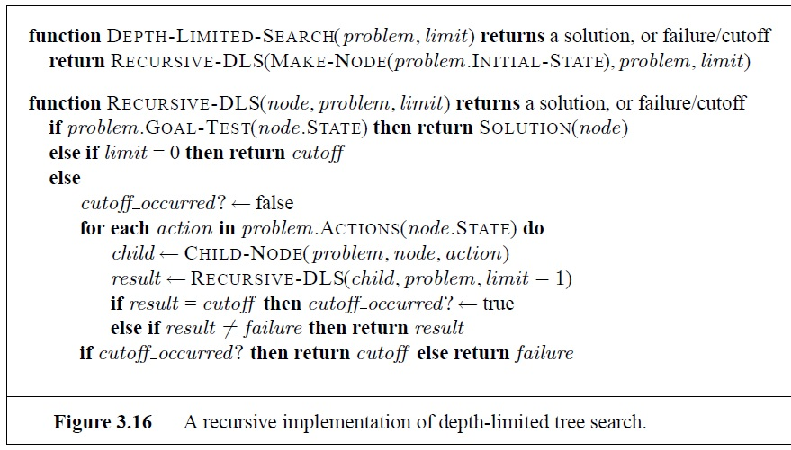

Slide 43
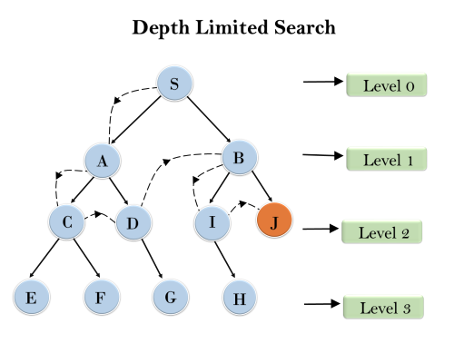
Advantages:
Depth-limited search is Memory efficient.
Disadvantages:
Depth-limited search also has a disadvantage of incompleteness.
It may not be optimal if the problem has more than one solution.

Slide 44
Iterative Deepening Depth-first Search
A combination of DFS and BFS algorithms, Iterative Deepening Depth-First Search identifies the best depth limit, by gradually increasing the limit until the goal is achieved.
Iterative deepening search (or iterative deepening depth-first search) is a general strategy, ITERATIVE DEEPENING SEARCH often used in combination with depth-first tree search, that finds the best depth limit.
It does this by gradually increasing the limit—first 0, then 1, then 2, and so on—until a goal is found.
This will occur when the depth limit reaches d, the depth of the shallowest goal node.
This searching strategy is extremely beneficial, as it combines the benefits of both Breadth-First Search and Depth-First Search.
The only drawback associated with this method is that it performs the search and work of previous stages.
The algorithm is shown in Figure. Iterative deepening combines the benefits of depth-first and breadth-first search.

Slide 45
Like breadth-first search, it is complete when the branching factor is finite and optimal when the path cost is a non decreasing function of the depth of the node.
Iterative deepening search may seem wasteful because states are generated multiple times.
It turns out this is not too costly. The reason is that in a search tree with the same (or nearly the same) branching factor at each level, most of the nodes are in the bottom level, so it does not matter much that the upper levels are generated multiple times.
In an iterative deepening search, the nodes on the bottom level (depth d) are generated once, those on the unlike the other two search algorithms, IDDFS is complete and is used to perform iterations of depth-limited searches while increasing the expected runtime.
Moreover, if a solution exists, IDDFS will find a solution path with the fewest arcs.

Slide 46
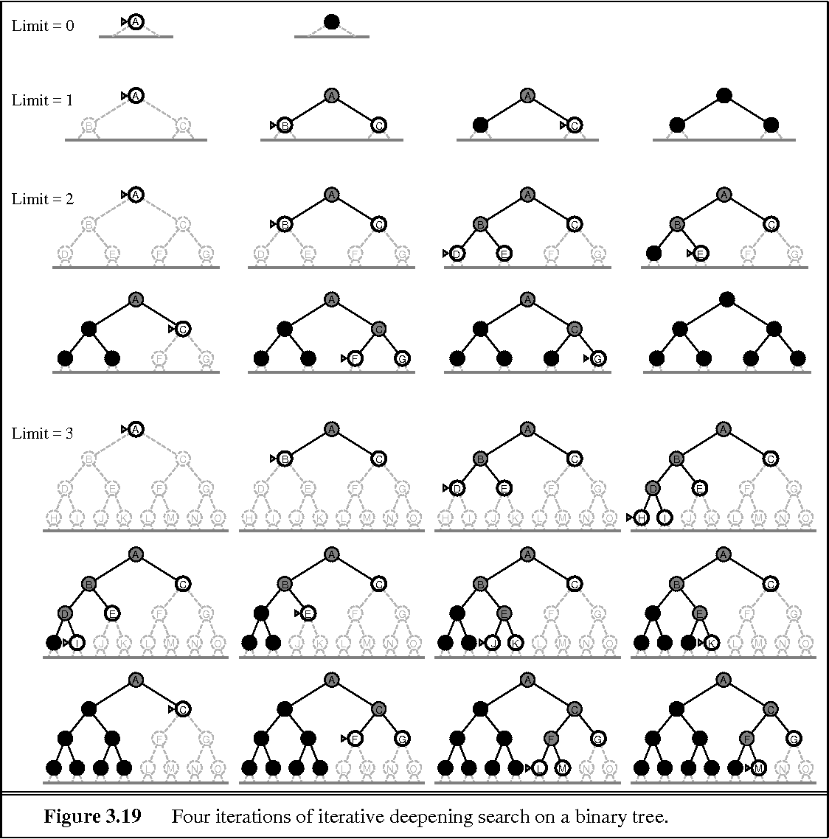

Slide 47
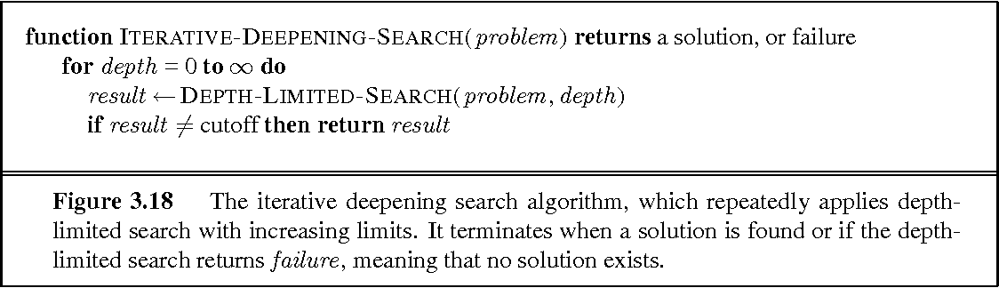
Advantages:
It combines the benefits of BFS and DFS search algorithm in terms of fast search and memory efficiency.
Disadvantages:
The main drawback of IDDFS is that it repeats all the work of the previous phase.

Slide 48
Bidirectional Search
The idea behind bidirectional search is to run two simultaneous searches—one forward from the initial state and the other backward from the goal—hoping that the two searches meet in the middle.
Bidirectional search is implemented by replacing the goal test with a check to see whether the frontiers of the two searches intersect; if they do, a solution has been found.
It is important to realize that the first such solution found may not be optimal, even if the two searches are both breadth-first; some additional search is required to make sure there isn’t another short-cut across the gap.
The check can be done when each node is generated or selected for expansion and, with a hash table, will take constant time.
Advantages: Disadvantages:
* Bidirectional search is fast. * Implementation of the bidirectional search tree is difficult.
* Bidirectional search requires less memory

Slide 49
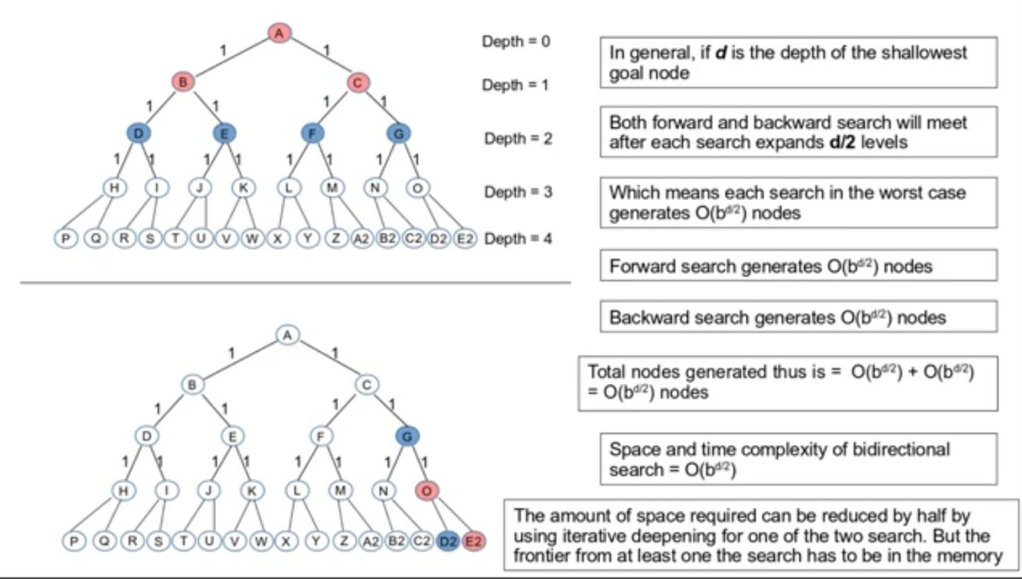
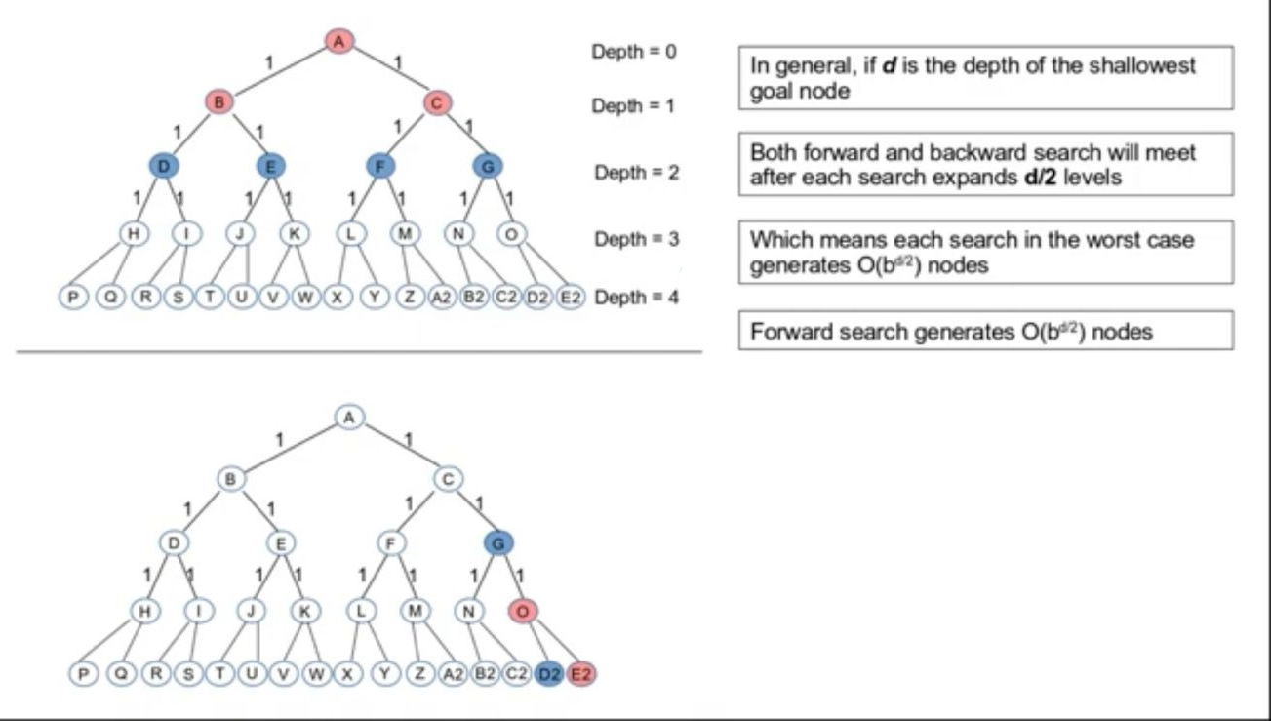
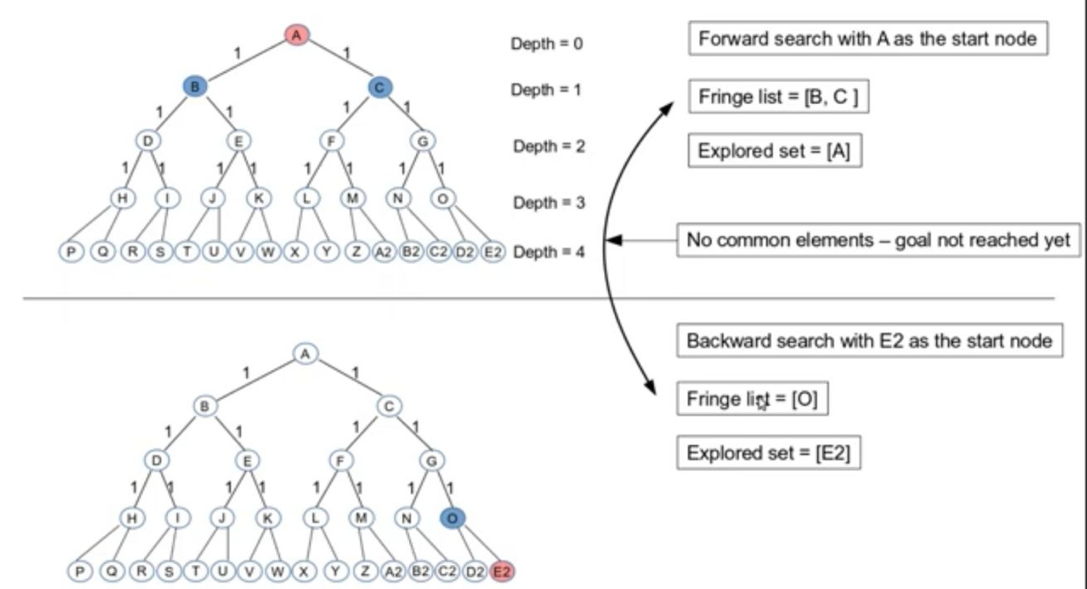
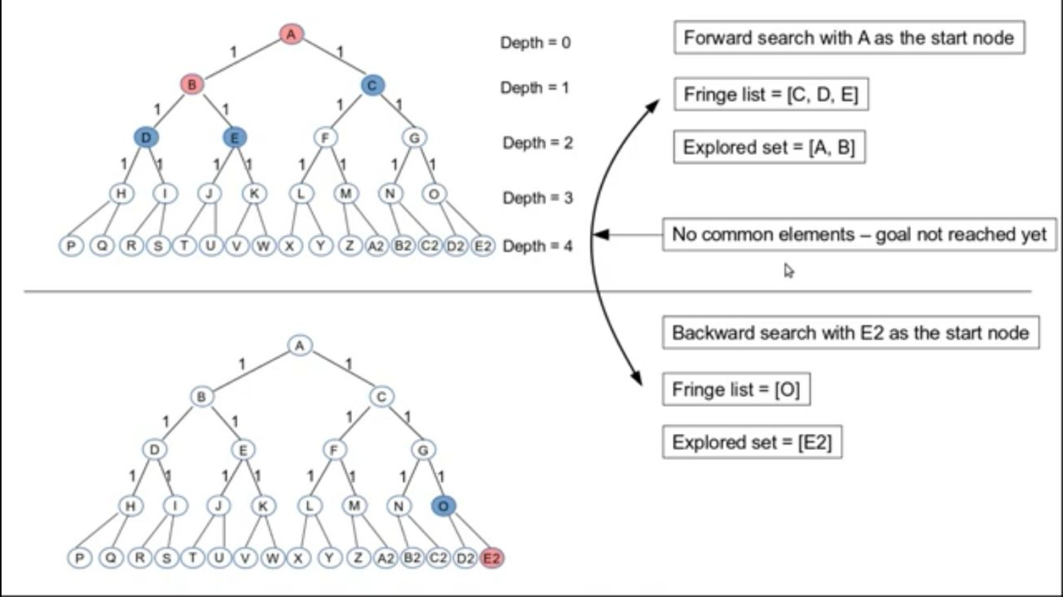
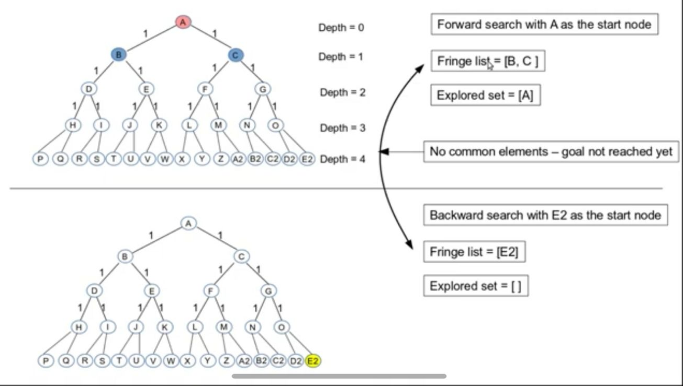
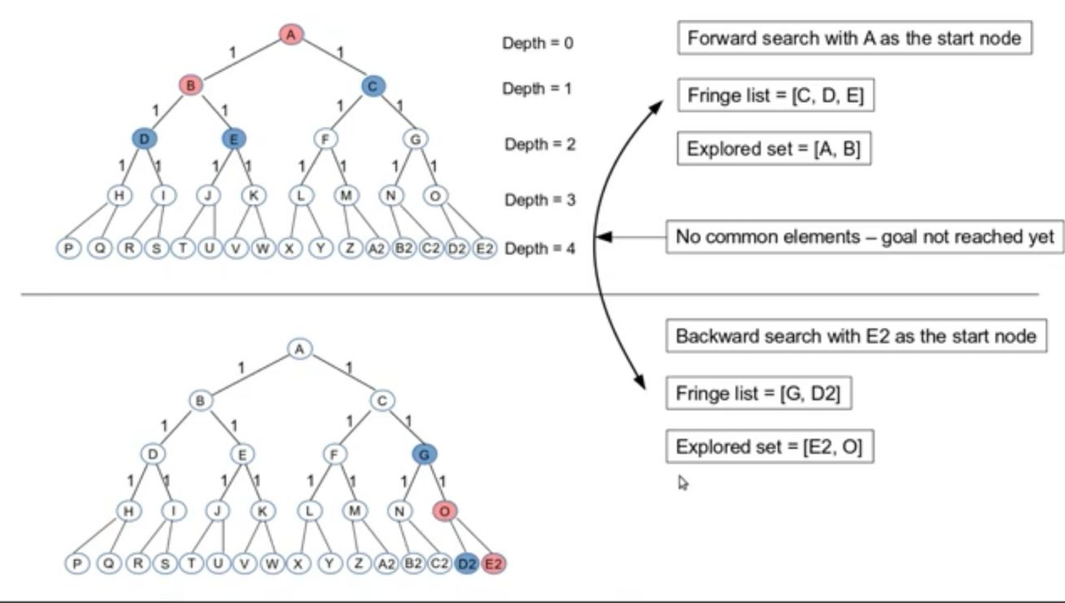
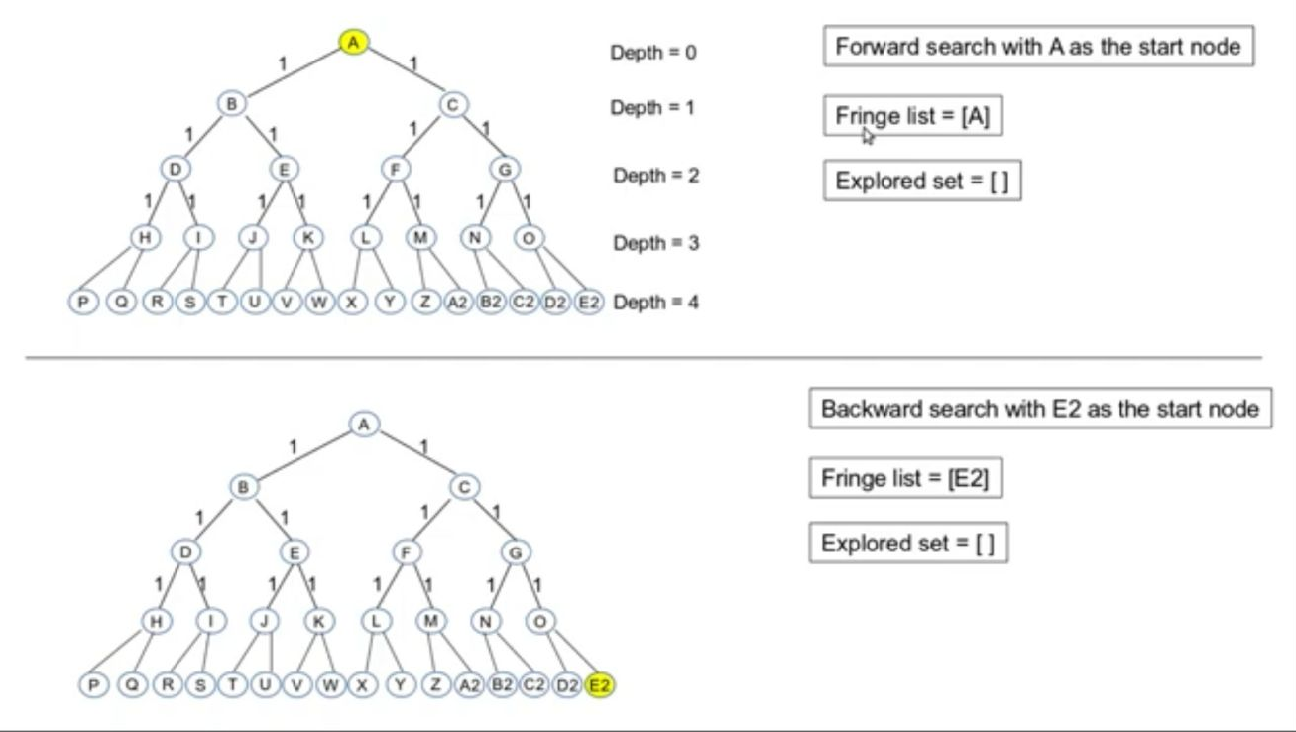
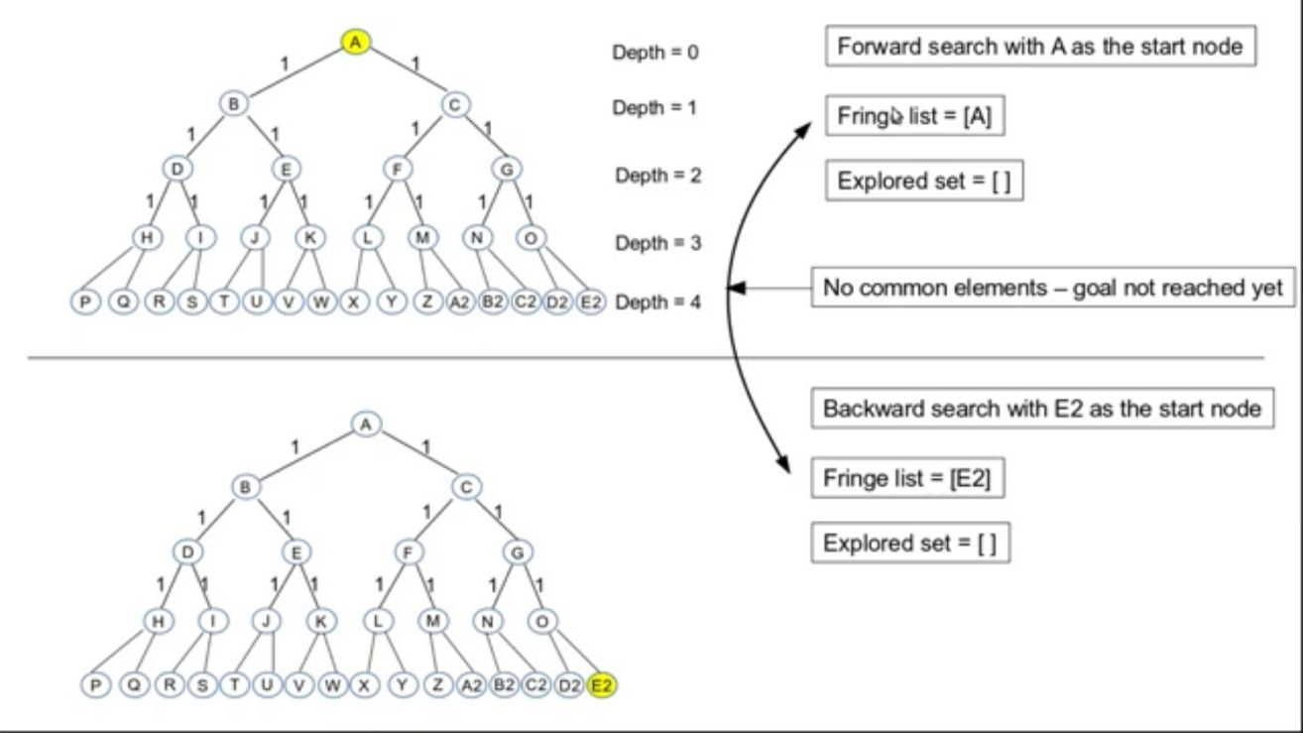
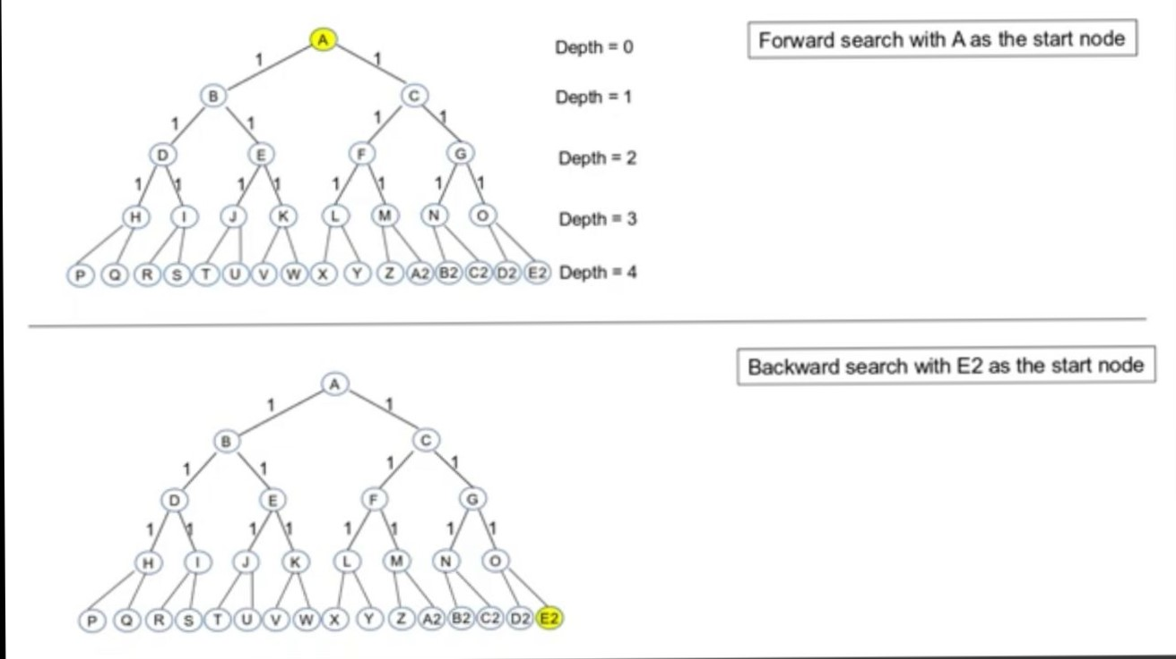
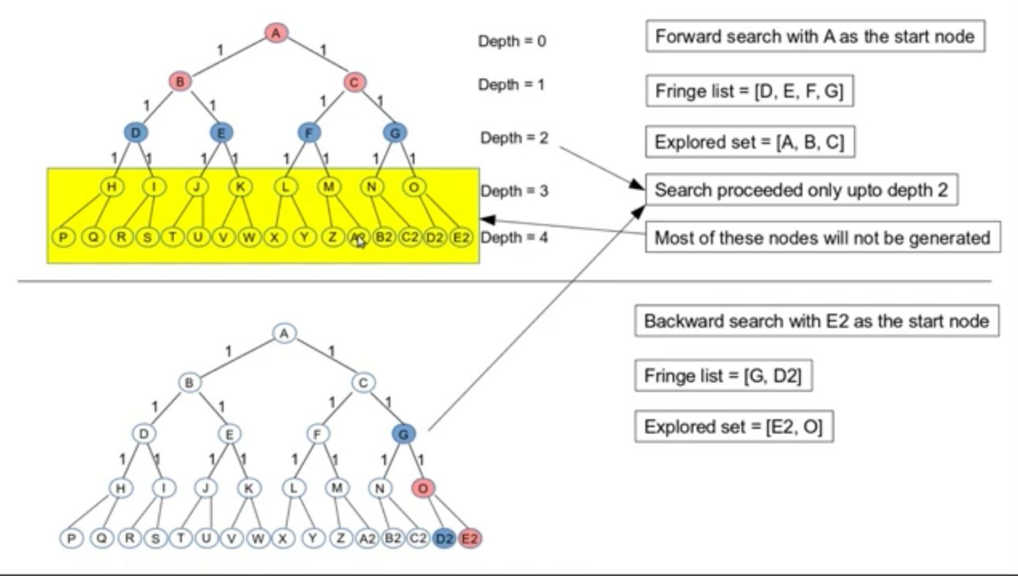
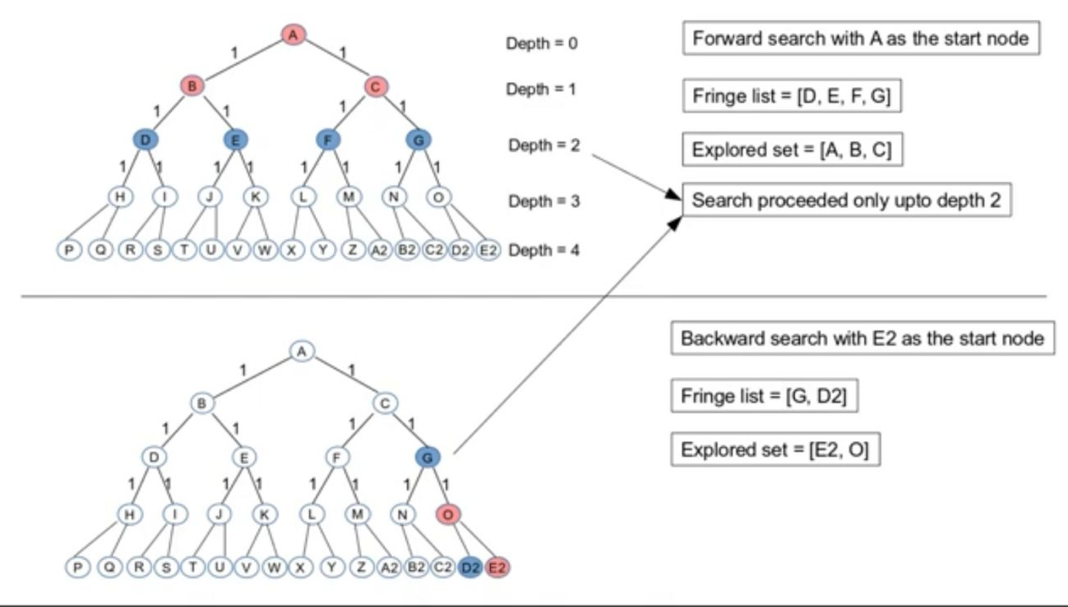

Slide 50
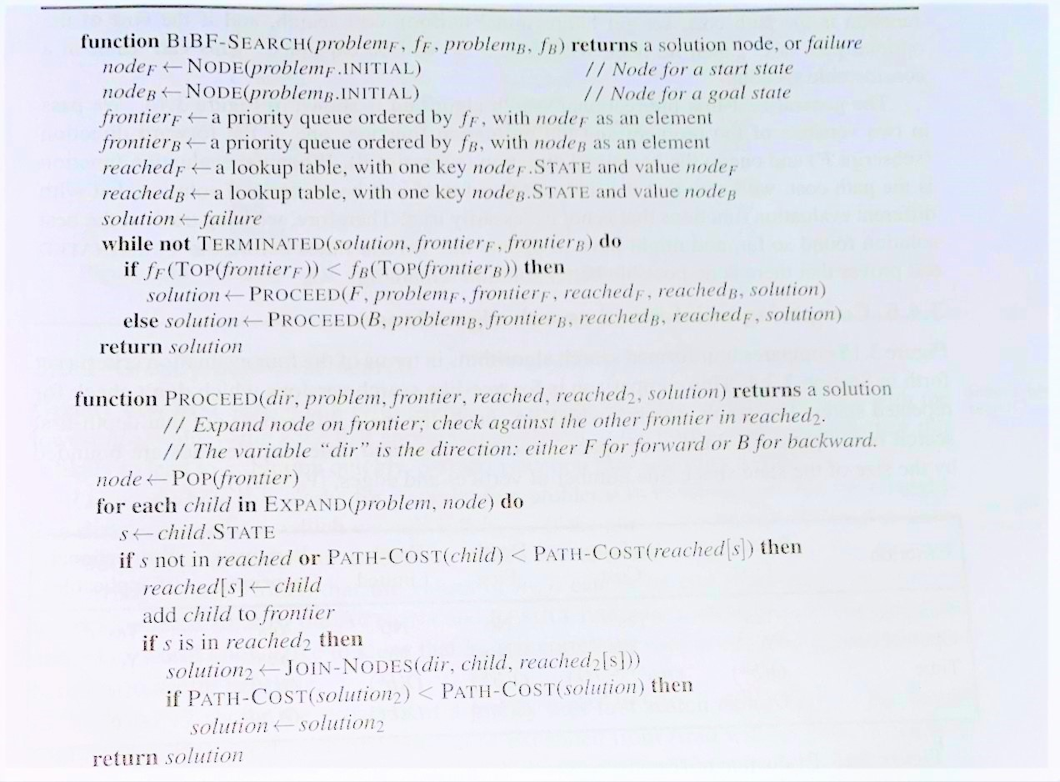
.

Slide 51
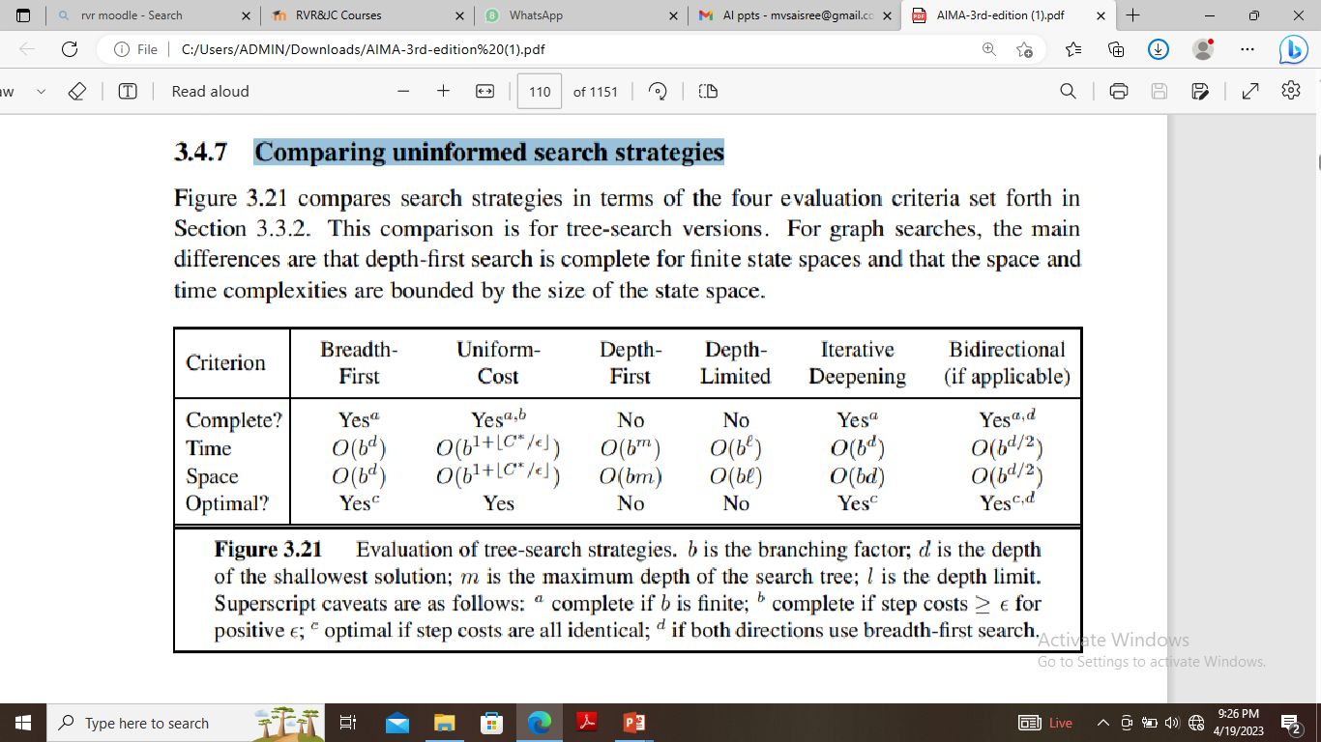
Comparing uninformed search strategies

Slide 52
1.13 Heuristic(Informed) Search Techniques
Heuristic is a method that involves an adapting approach to a problem based on previous solutions to similar problems.
Informed search strategy—one that uses problem-specific hints about the location of the goals.
The hints come in the form of Heuristic function denoted by h(n).
where h(n) is the estimated cost of the cheapest path from node n to goal state.
It is a criterion for determining which among several alternatives will be the most effective to achieve some goal.
The principle of a heuristic can be applied to various problems in mathematics, science and optimization by applying heuristics computationally.
It can find solutions more efficiently than can an uninformed strategy.

Slide 53
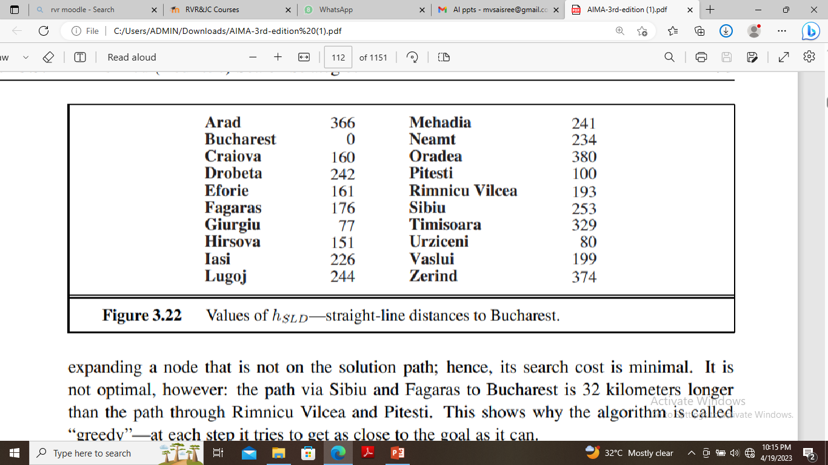
Greedy best first search
Greedy best-first search tries to expand the node with lowest h(n) value.-the node that appears to be closest to the goal.
Thus, it evaluates nodes by using heuristic function, f(n) = h(n).
Consider route-finding problem in Romania; we use the straight-line distance heuristic, which we will call hSLD .
If the goal is Bucharest, we need to know STRAIGHT-LINE DISTANCES to Bucharest. For example, hSLD (In(Arad)) = 366.

Slide 54
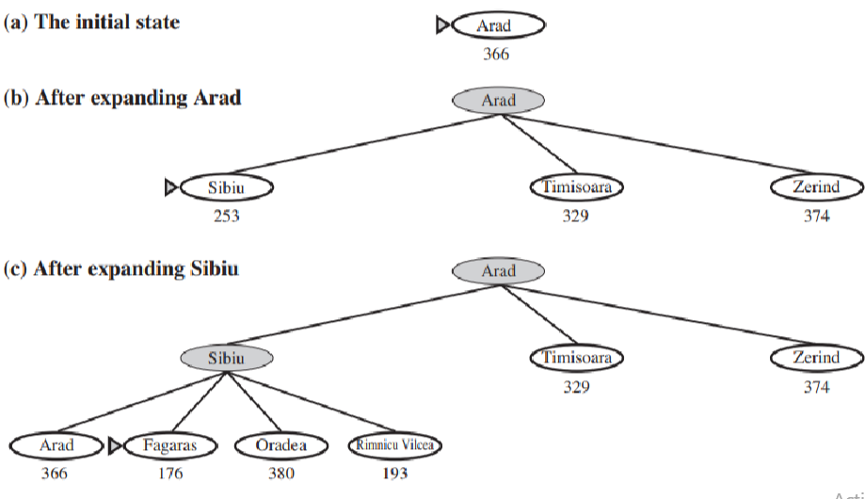

Slide 55
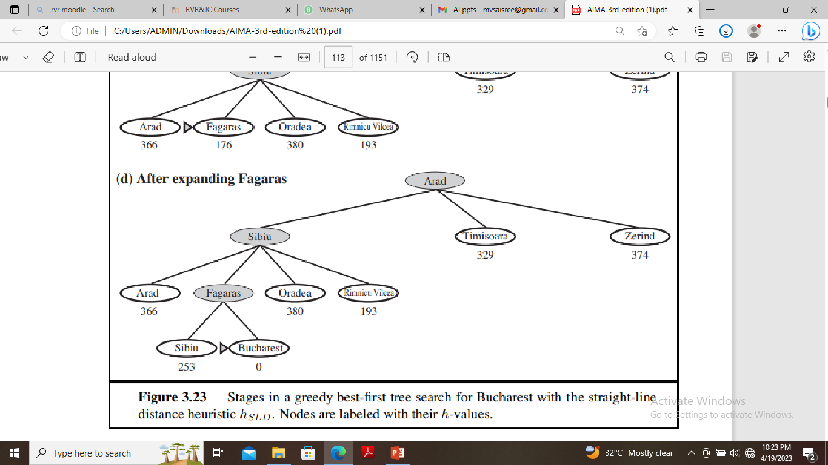

Slide 56
A * Algorithm
The most widely known form of best-first search is called A∗ search .
It uses the evaluation function f(n) = g(n) + h(n) . ,
where g(n) gives the path cost from the start node to node n, and
h(n) is the estimated cost of the cheapest path from n to the goal,
f(n) is estimated cost of the cheapest solution through n .
Thus, if we are trying to find the cheapest solution, then try to expand the node with the lowest value of g(n) + h(n).
The algorithm is identical to UNIFORM-COST-SEARCH except that A∗ uses g + h instead of g.

Slide 57
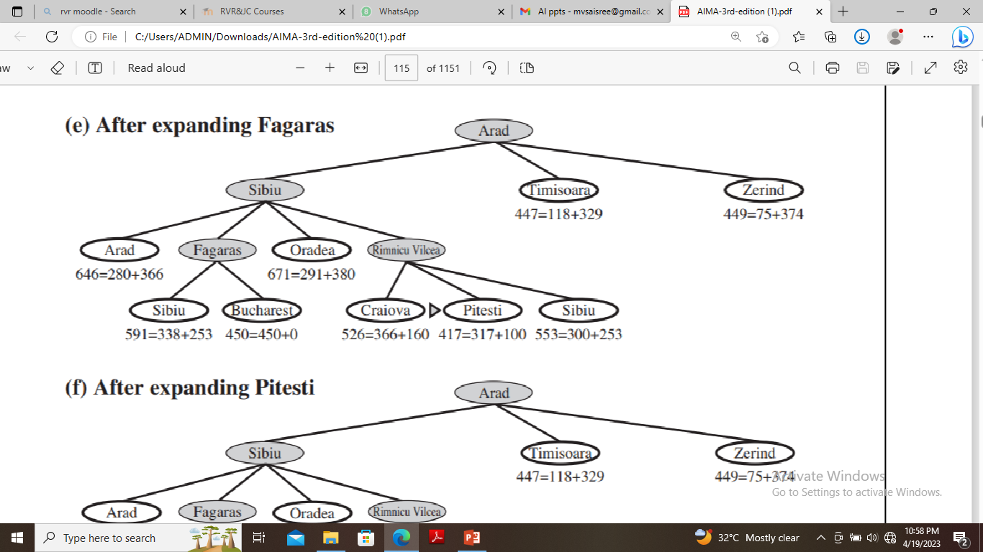
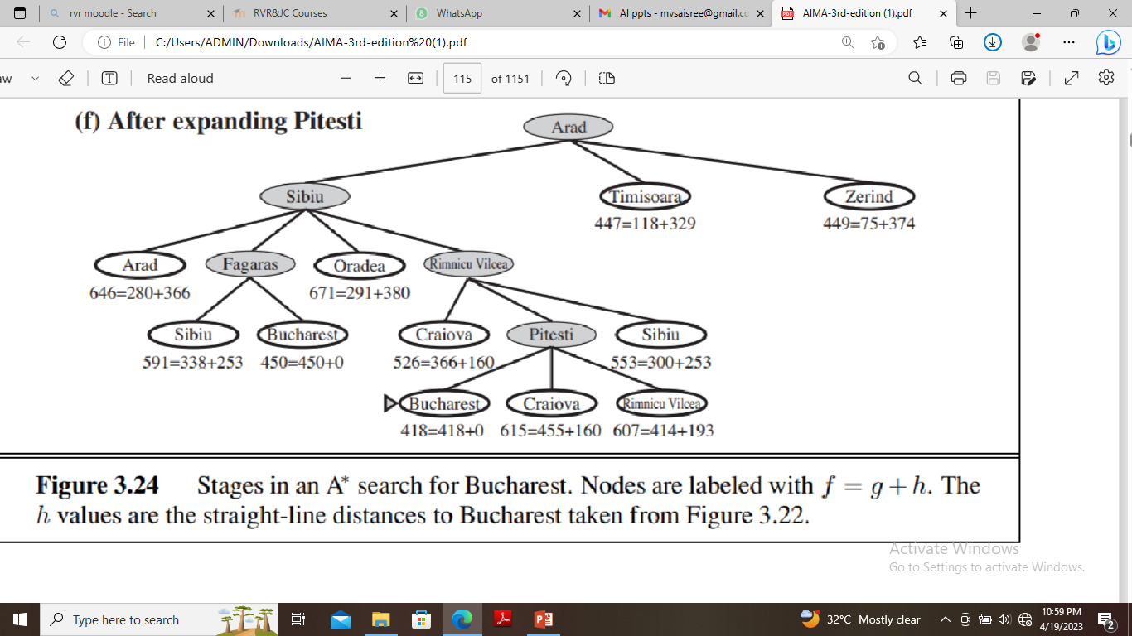
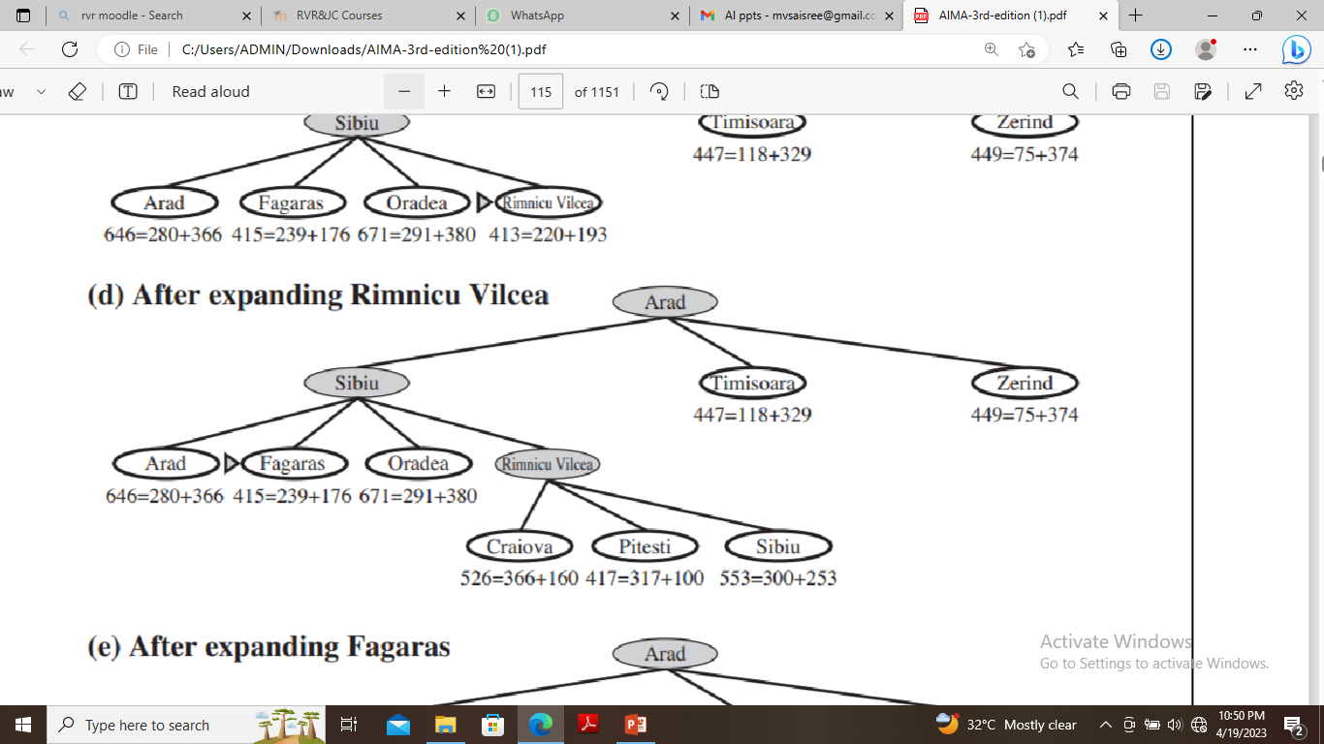
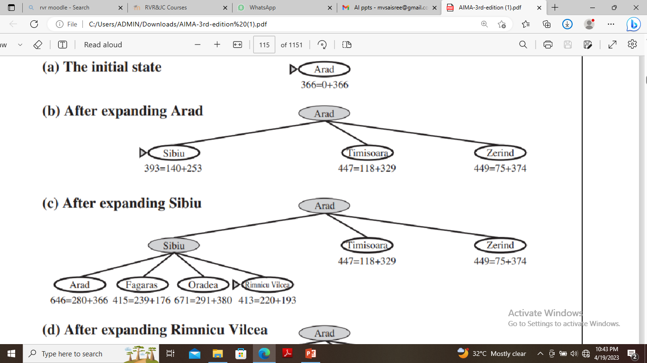

Slide 58
A* algorithm is called OR graph / tree search algorithm.
A* algorithm incrementally searches all the routes starting from the start node until it finds the shortest path to a goal.
Starting with a given node, the algorithm expands the node with the lowest f(X) value.
It maintains a set of partial solutions.
Unexpanded leaf nodes of expanded nodes are stored in a queue with corresponding f values. This queue can be maintained as a priority queue.

Slide 59
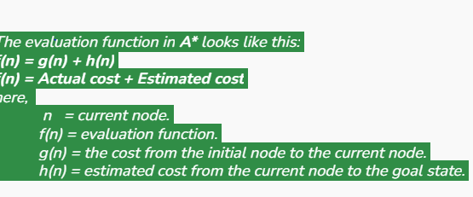

Conditions for optimality
The first condition we require for optimality is that h(n) be an admissible heuristic.
In computer science, the heuristic function h(n) is referred to as acceptable, and it is always less than or equal to the actual cost, which is the true cost from the present point in the path. H(n) is never bigger than h*(n) in this context.
An admissible heuristic is one that never overestimates the cost to reach the goal.
Second condition is consistency (or sometimes monotonicity) MONOTONICITY is required only for applications of A∗ to graph search.
A heuristic h(n) is consistent if, for every node n and every successor n’ of n generated by any action a, the estimated cost of reaching the goal from n is no greater than the step cost of getting to n’ plus the estimated cost of reaching the goal from n’ : h(n) ≤ c(n, a, n’) + h(n’ ) .
This is a form of the general triangle inequality, which stipulates that each side of a triangle cannot be longer than the sum of the other two sides.

Slide 60
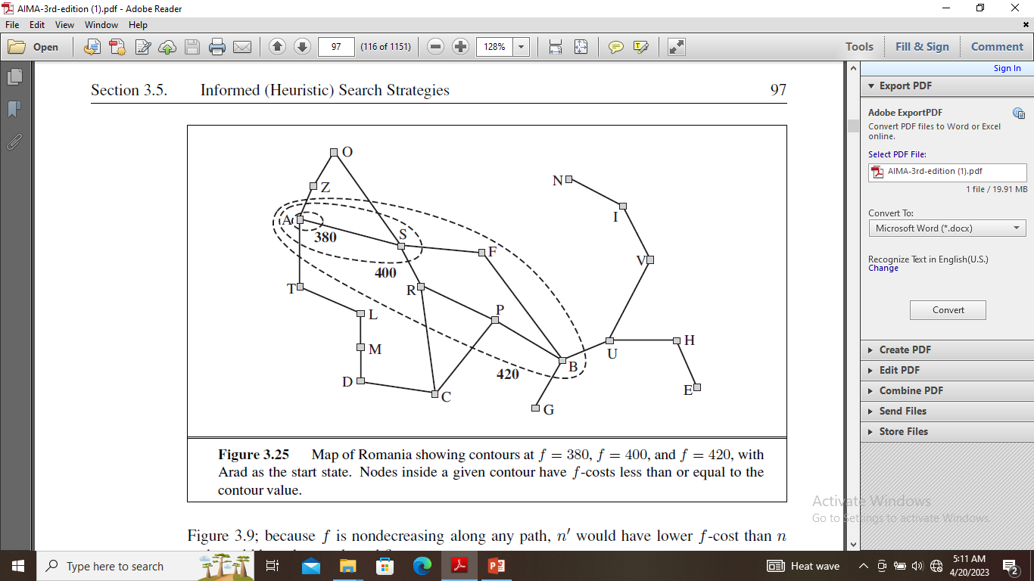
Search Contours
f-costs are non-decreasing along any path also means that we can draw contours in the state space, just like the contours CONTOUR in a topographic map.
We can also form contours in Uniform cost search also but with g not with h+g. g costs are monotonic , the path cost always increases as we go along the path because g costs are always positive.
Inside the contour labeled 400, all nodes have f(n) less than or equal to 400,and so on.

Slide 61
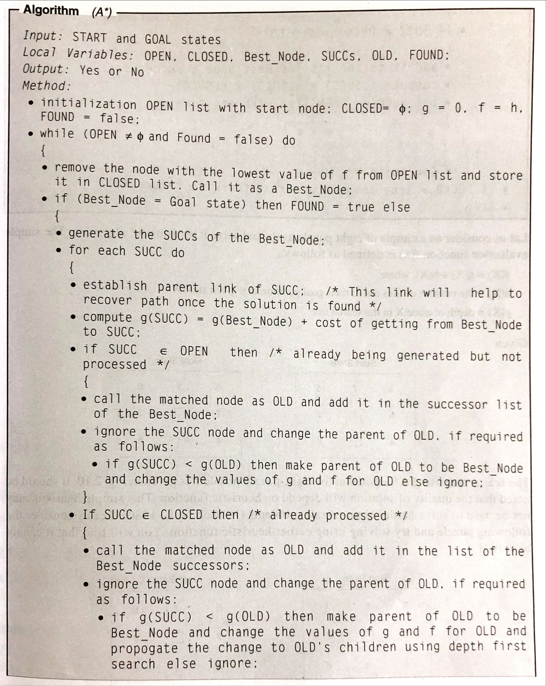

Slide 62
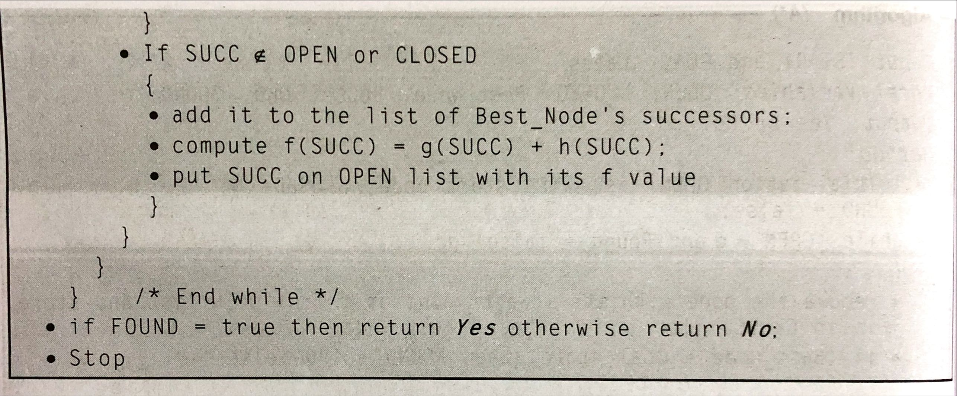

Slide 63
Memory-bounded heuristic search
The simplest way to reduce memory requirements for A∗ is to adapt the idea of iterative deepening to the heuristic search context, resulting in the Iterative-Deepening A∗ (IDA∗) algorithm.
The main difference between IDA∗ and standard iterative deepening is that the cutoff used is the f-cost (g+h) rather than the depth.
At each iteration, the cutoff value is the smallest f-cost of any node that exceeded the cutoff on the previous iteration.
IDA∗ is practical for many problems with unit step costs and avoids the substantial overhead associated with keeping a sorted queue of nodes.
Unfortunately, it suffers from the same difficulties with real valued costs.
There are two other memory-bounded algorithms, called RBFS and MA.

Slide 64
Recursive best-first search (RBFS)
Its structure is similar to that of a recursive depth-first search, but rather than continuing indefinitely down the current path, it uses the f limit variable to keep track of the f-value of the best alternative path available from any ancestor of the current node.
If the current node exceeds this limit, the recursion unwinds back to the alternative path.
As the recursion unwinds, RBFS replaces the f-value of each node along the path with a backed-up value—the best f-value of its children.
In this way, RBFS remembers the f-value of the best leaf in the forgotten subtree and can therefore decide whether it’s worth re-expanding the subtree at some later time.

Slide 65
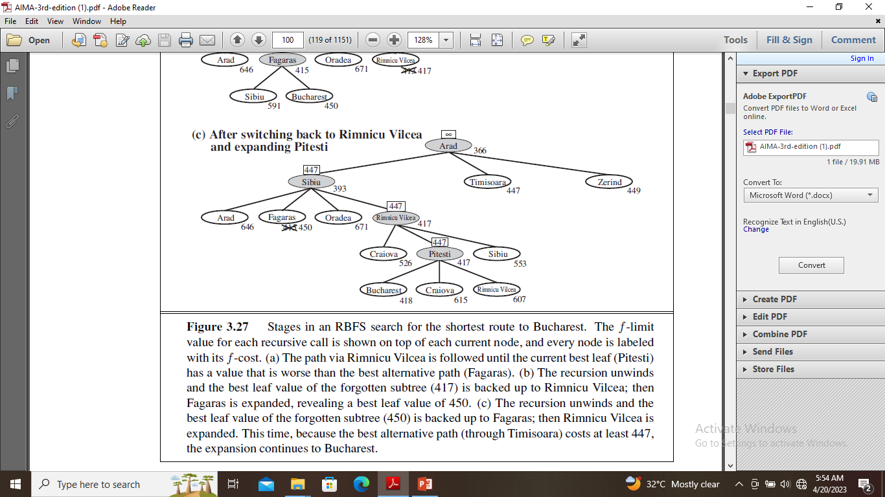
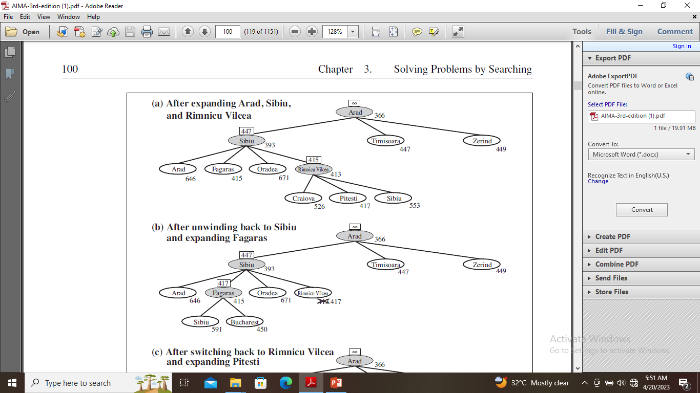

Slide 66
The f-limit value for each recursive call is shown on top of each current node, and every node is labeled with its f-cost.
The path via Rimnicu Vilcea is followed until the current best leaf (Pitesti) has a value that is worse than the best alternative path (Fagaras).
The recursion unwinds and the best leaf value of the forgotten subtree (417) is backed up to Rimnicu Vilcea; then Fagaras is expanded, revealing a best leaf value of 450.
The recursion unwinds and the best leaf value of the forgotten subtree (450) is backed up to Fagaras; then Rimnicu Vilcea is expanded. This time, because the best alternative path (through Timisoara) costs at least 447, the expansion continues to Bucharest.

Slide 67
SMA∗
IDA∗ and RBFS suffer from using too little memory.
Between iterations, IDA∗ retains only a single number: the current f-cost limit.
RBFS retains more information in memory, but it uses only linear space: even if more memory were available, RBFS has no way to make use of it.
Because they forget most of what they have done, both algorithms may end up re-expanding the same states many times over.
It seems sensible, therefore, to use all available memory, two algorithms that do this are MA∗ (memory-bounded A∗) and SMA∗ (simplified MA∗).
SMA∗ proceeds just like A∗, expanding the best leaf until memory is full.
At this point, it cannot add a new node to the search tree without dropping an old one.
SMA∗ always drops the worst leaf node—the one with the highest f-value.
Like RBFS, SMA∗ then backs up the value of the forgotten node to its parent.

Slide 68
What if all the leaf nodes have the same f-value?
To avoid selecting the same node for deletion and expansion, SMA∗ expands the newest best leaf and deletes the oldest worst leaf.
These coincide when there is only one leaf, but in that case, the current search tree must be a single path from root to leaf that fills all of memory.
If the leaf is not a goal node, then even if it is on an optimal solution path, that solution is not reachable with the available memory.
Therefore, the node can be discarded exactly as if it had no successors.
Learning to Search better
Could an agent learn how to search better? The answer is yes, and the method rests on an important concept called the meta-level state space.
Each state in a meta-level state space captures the internal (computational) state of a program that is searching in an object-level state space.
Each action in the meta-level state space is a computation step that alters the internal state(meta-level learning).

Slide 69
1.14 Heuristic Functions
The 8-puzzle was one of the earliest heuristic search problems.
The object of the puzzle is to slide the tiles horizontally or vertically into the empty space until the configuration matches the goal configuration.
When the empty tile is in the middle, four moves are possible; when it is in a corner, two; and when it is along an edge, three.
The branching factor is about 3 .The average solution cost for a randomly generated 8-puzzle instance is about 22 steps.
This means that an exhaustive tree search to depth 22 would look at about 322 ≈ 3.1 × 1010 states.
If we want to find the shortest solutions by using A∗, we need a heuristic function that never overestimates the number of steps to the goal.
There is a long history of such heuristics for the 15-puzzle; here are two commonly used candidates:.h1 and h2.

Slide 70
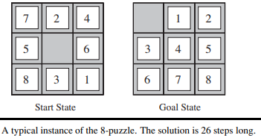
h1 = the number of misplaced tiles., all of the eight tiles are out of position, so the start state would have h1 = 8. (h1 is an admissible heuristic because it is clear that any tile that is out of place must be moved at least once.)
h2 = the sum of the distances of the tiles from their goal positions. (Because tiles cannot move along diagonals, the distance we will count is the sum of the horizontal and vertical distances). h2 is also admissible because all any move can do is move one tile one step MANHATTAN DISTANCE closer to the goal.
Tiles 1 to 8 in the start state give a Manhattan distance
of h2 = 3 + 1 + 2 + 2 + 2 + 3 + 3 + 2 = 18.
As expected, neither of these overestimates the true
solution cost, which is 26.
The quality of a heuristic is based on effective branching
factor b∗.
The effective branching factor is the number of
successors generated by a "typical" node for a given search problem.

Slide 71
Generating admissible heuristics from relaxed problems
If the rules of the puzzle were changed so that a tile could move anywhere instead of just to the adjacent empty square, then h1 would give the exact number of steps in the shortest solution.
Similarly, if a tile could move one square in any direction, even onto an occupied square, then h2 would give the exact number of steps in the shortest solution.
A problem with fewer restrictions on the actions is called a relaxed problem.
For example, if the 8-puzzle actions are described as
  tile can move from square A to square B if
  A is horizontally or vertically adjacent to B and B is blank,
We can generate three relaxed problems by removing one or both of the conditions:
        (a) tile can move from square A to square B if A is adjacent to B.
        (b) tile can move from square A to square B if B is blank.
        (c) tile can move from square A to square B.

Slide 72
Generating admissible heuristics from sub-problems: Pattern databases
Admissible heuristics can also be derived from the solution cost of a sub-problem of a given problem.
The sub-problem involves getting tiles 1, 2, 3, 4 into their correct positions.
Clearly, the cost of the optimal solution of this sub-problem is a lower bound on the cost of the complete problem.
It turns out to be more accurate than Manhattan distance in some cases.
The idea behind pattern databases is to store these exact solution costs for every possible sub-problem instance—in our example, every possible configuration of the four tiles and the blank.
The heuristics obtained from the 1-2-3-4 database and the 5-6-7-8 could be added, since the two sub-problems seem not to overlap.

Slide 73
